Slide 1
Insight stream : navigate The news landscape
Submitted by:
m.Abinaya p.Priyadarshini
v.Priyadharshni g.Aarthi
k.keerthana

Slide 2
introduction
In today’s digital world, getting news is easier than ever, but it also comes with challenges. Social media and online platforms spread news quickly, but they also spread fake information.
Many people struggle to tell the difference between real and false news. AI helps by showing personalized content, but it can also trap people in their own beliefs by showing only similar views.
Ethical journalism and fact-checking are important to keep news honest and trustworthy. Governments and tech companies need to control fake news while allowing free speech.
People should learn how to check if news is true before believing or sharing it. By being careful and choosing reliable sources, we can stay informed

Slide 3
Software requirement
Front-end development:
1.html
2.css
3.react.js
Back-end development
1.node.js
Data source:
1.newsapi

Slide 4
Feature of the app
1.Real-Time News Updates:
Always Up-to-Date: The app fetches the latest news articles from NewsAPI in real-time, ensuring that users have access to current and relevant news.
2. Categorized News
Categories Include:
Technology
Business
Sports
Health
Entertainment
3. User-Friendly Interface
Clean Design: The app features a minimalist and easy-to-use design, making it simple for users to navigate and read articles without distractions.
Responsive Layout: Built with Bootstrap, the app adapts to any screen size, offering an optimal reading experience on desktops, tablets, and smartphones.
4. Secure and private:
https for security: all data between the app and newsapi is encrypted using https to protect user privacy and prevent data interception.

Slide 5
Feature of the app
1.Real-Time News Updates:
Always Up-to-Date: The app fetches the latest news articles from NewsAPI in real-time, ensuring that users have access to current and relevant news.
2. Categorized News
Categories Include:
Technology
Business
Sports
Health
Entertainment
3. User-Friendly Interface
Clean Design: The app features a minimalist and easy-to-use design, making it simple for users to navigate and read articles without distractions.
Responsive Layout: Built with Bootstrap, the app adapts to any screen size, offering an optimal reading experience on desktops, tablets, and smartphones.
4. Secure and private:
https for security: all data between the app and newsapi is encrypted using https to protect user privacy and prevent data interception.

Slide 6
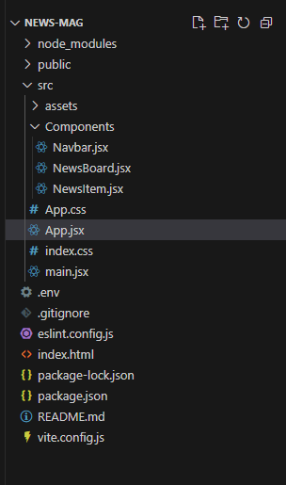
Project structure

Slide 7
Program and explanation
1. Index.html
This HTML code creates a simple webpage for a project called "News Mag." It includes:
Meta tags for setting the character encoding (UTF-8) and making the page responsive on different devices.
A title for the page ("News Mag").
A link to Bootstrap CSS for styling the page with Bootstrap.
A <div> element with the ID "root" to serve as a container for the app (likely React-based).Scripts for loading React and Bootstrap's JavaScript components.

Slide 8
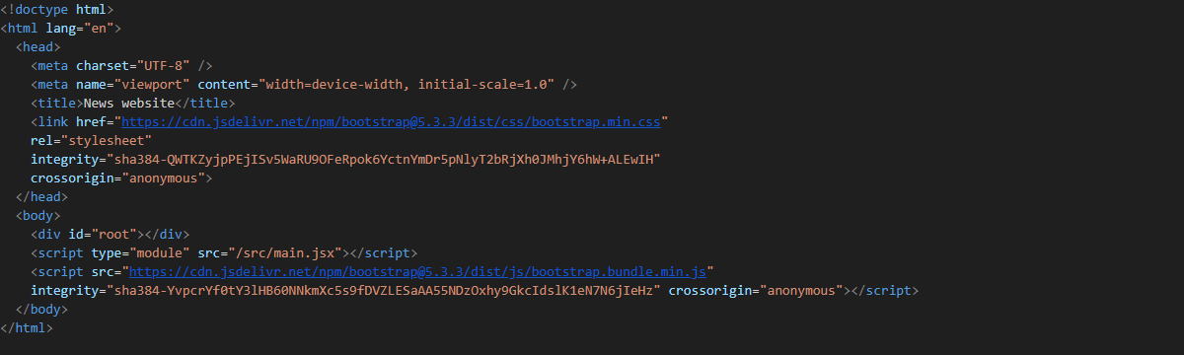
1.index.html

Slide 9
2. navbar.jsx:
This code defines a responsive navigation bar in React that allows users to select different categories (Technology, Business, Health, Sports) by clicking on links.
When a category is clicked, it triggers the setCategory function to update the selected category.
The navbar also includes a toggle feature for small screens using Bootstrap classes.

Slide 10
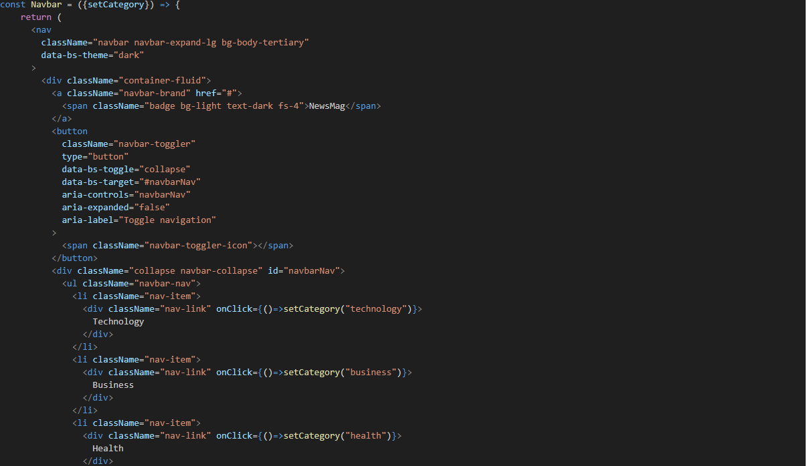
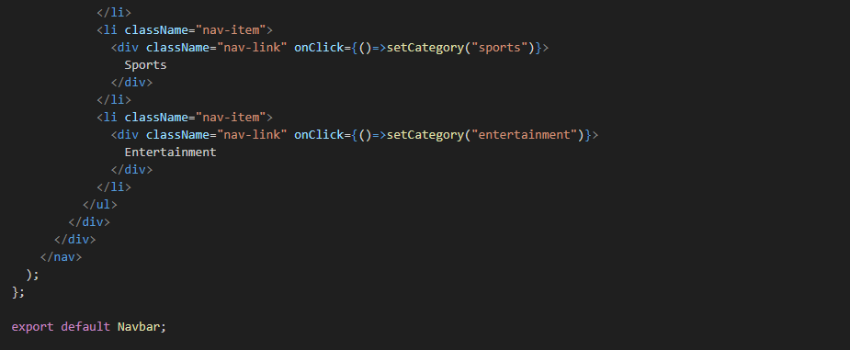
2.Navbar.jsx

Slide 11
3.NewsBoard.jsx:
This code defines a NewsBoard component that displays news articles based on the selected category.
It uses the useEffect hook to fetch the latest news from an API whenever the category prop changes.
The articles are stored in the articles state, and each article is displayed using the NewsItem component. The news articles are updated whenever the category is updated, providing real-time changes based on user selection.

Slide 12
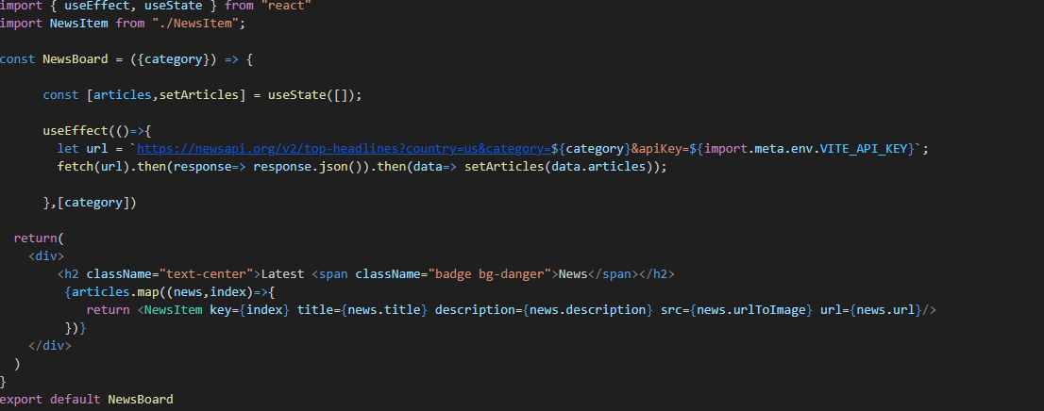
3.Newsboard.jsx

Slide 13
4.NewsItem.jsx:
The NewsItem component displays an individual news article with a title, description, image, and a "Read More" link.
it falls back to a default image. The title and description are truncated to fit the card layout.
The title is sliced to show the first 50 characters, and the description is sliced to 90 characters, with a fallback description if it's missing.
A "Read More" button links to the full article using the url prop.

Slide 14
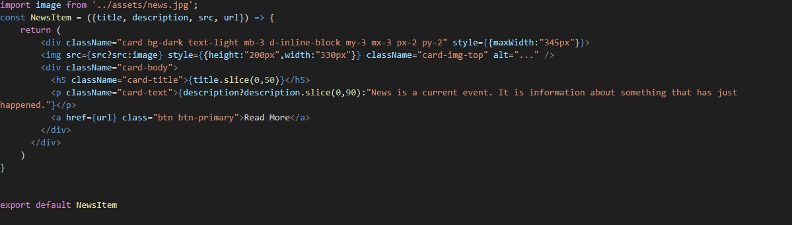
4.NewsItem.jsx

Slide 15
5.App.jsx:
This App component serves as the main entry point of the application, managing the selected news category and rendering the Navbar and NewsBoard components.
Explanation:
State Management: Uses useState to store the category, defaulting to "general".
Navbar Component: Passes setCategory to allow category selection.
NewsBoard Component: Receives category and displays news based on the selected category.
Important Lines:
Initializes state to store the selected news category.Passes setCategory to Navbar so users can change the category.
Passes category to NewsBoard to fetch and display relevant news.

Slide 16
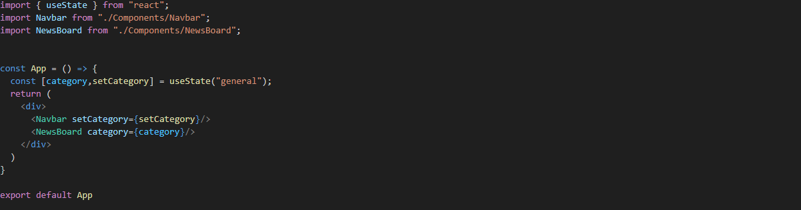
5.App.jsx:

Slide 17
6.main.jsx:
This code initializes a React application and renders the main component (App) inside the root element of an HTML page.
Important Lines:
1. import { StrictMode } from "react"; – Enables additional checks and warnings in development mode.
2. import { createRoot } from "react-dom/client"; – Uses React 18’s createRoot API for rendering.
3. createRoot(document.getElementById("root")).render(<StrictMode><App/>
</Strictmode>); – Selects the root HTML element and renders the App component inside it.

Slide 18

6.main.jsx:

Slide 19
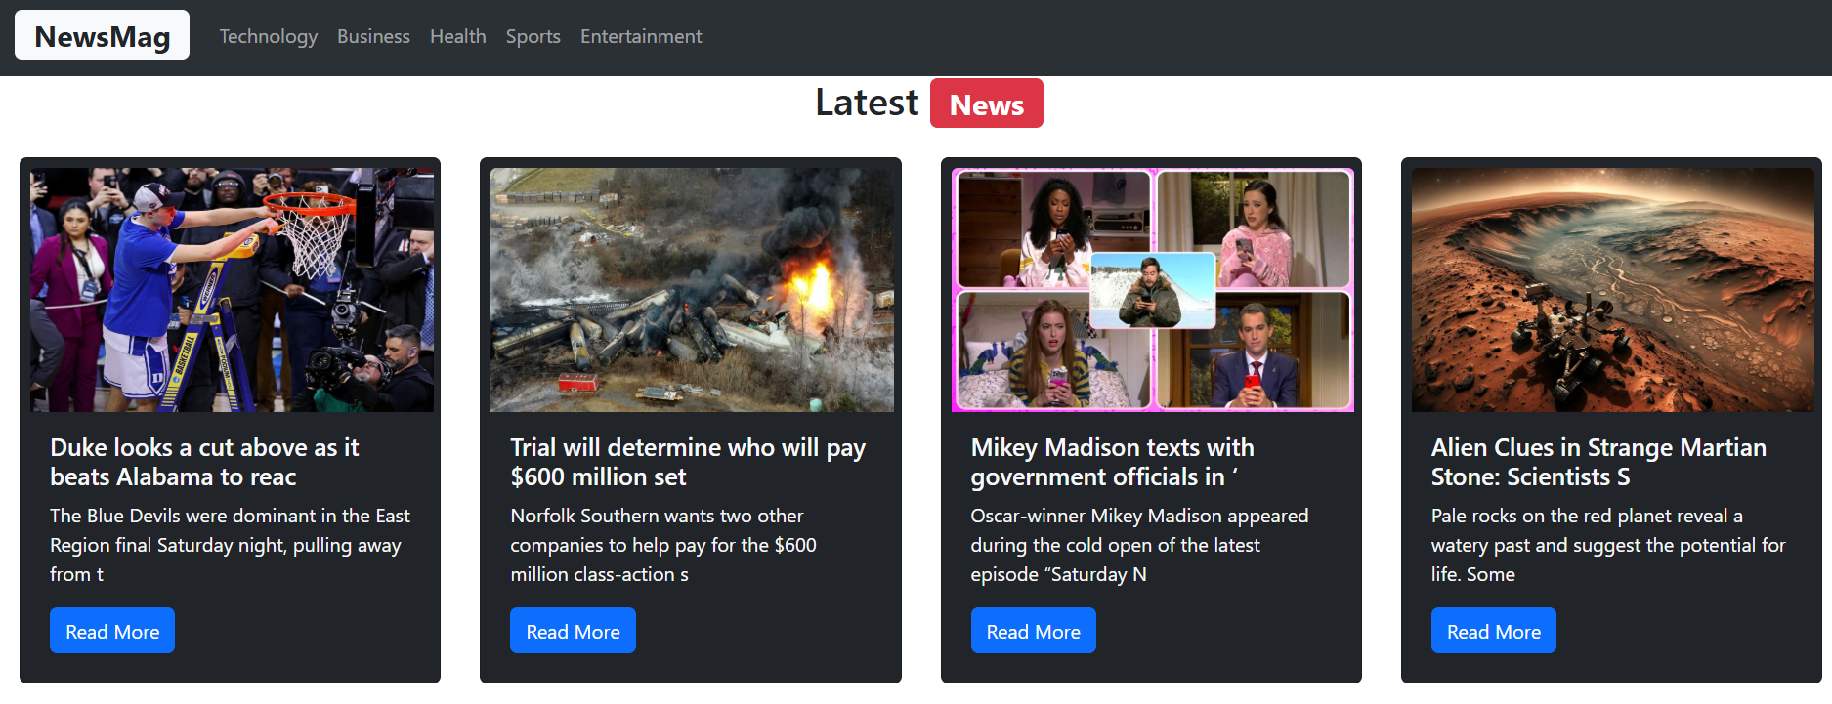
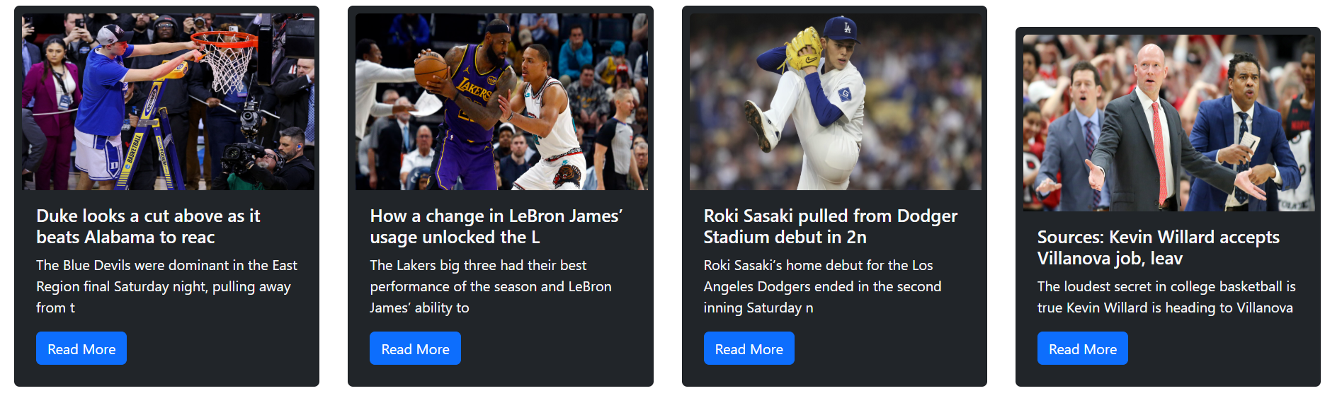
Output

Slide 20
THANK YOU

